Slide 1
LMS Deployment Models

Slide 2
LMS Deployment Models

Slide 3
Introduction
After Deploying LMS in all the H-12 Schools in Phase V of LMS Deployment, in the next phase NUST LMS Central will deploy LMS in NUST Constituents outside H-12.
The purpose of this presentation is to propose which type of LMS deployment model would be used(Centralized or Decentralized);
Till now NUST LMS Central has used the centralized approach of deploying LMS which has been a great success

Slide 4
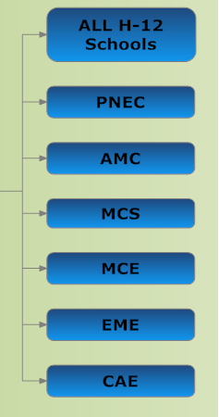
NUST Constituents

Slide 5
NUST Constituents
No. of Institutes …………………………6
No. of Cities --------------------------------------3
No of Users---------------------------------------

Slide 6
Introduction
LMS Can be deployed in two
ways:
Centralized Model;
Decentralized Model;
We will explain the Pros & Cons of both
the Centralized & Decentralized Model.
Centralized Model
Decentralized Model

Slide 7
Introduction
The Factors which we have taken into
Consideration are:
Hardware;
Personnel;
Connectivity & Bandwidth;
Implementation;
Pros & Cons of Both the Models
Centralized Model
Decentralized Model

Slide 8
LMS Deployment Models

Slide 9
LMS Deployment Models
We will look at two models:
Centralized
De-Centralized
A third, Hybrid model can also be considered which is a combination of good aspects of both the models.

Slide 10
LMS Deployment Models
Centralized
The centralized model places all budget, Hardware ,decision-making, and operational staff in a central group (LMS Central) and uses shared services to service the needs of NUST Constituents.

Slide 11
An Overview of a Centralized Model

Slide 12
LMS Deployment Models
De-Centralized
The De-Centralized model would empower the Constituents to manage their own authentication and hardware resources only. LMS Central would implement LMS,manage and train the HR.

Slide 13
An Overview of a Decentralized Model
Centralized

Slide 14
An Overview of a Decentralized Model
Centralized

Slide 15
Centralized

Slide 16
LMS Deployment Models
Hybrid
Hybrid Model can also be used like Keeping the Database Central and de-centralizing the web servers which store course content;
Content can be pushed to the localized content servers which would solve two problems
i) Content no longer flows from a single central server through restricting pipelines;
ii) control of content is where it should be, at the local level.

Slide 17
Infrastructure & Hardware comparisons

Slide 18
Hardware Comparison
Centralized Vs. Decentralized
CENTRALIZED
For All Schools:
3 Servers with 48 GB,2Hex Core Processor with limited Storage
SAN Storage
Hardware for HR
VMware Licensing
Rack
DECENTRALIZED
For Each School:
2 Servers with 48 GB RAM,2Hex Core Processor with 3TB Storage
SAN Storage
Hardware for HR
VMware Licensing
Rack

Slide 19
HR Comparison
Centralized Vs. Decentralized
CENTRALIZED
For All Schools:
1 System Admin/ASA
1 LMS Coordinator per School
DPA for office work ;
DECENTRALIZED
For Each School:
1 System Admin/ASA per school;
1 LMS Coordinator per School
DPA for office work ;

Slide 20
Connectivity & Bandwidth
Centralized Vs. Decentralized
CENTRALIZED
For All Schools:
Connectivity on PERN 2 network
DECENTRALIZED
For Each School:
Current Connectivity on PERN 2 network per school

Slide 21
Application & Authentication
Centralized Vs. Decentralized
CENTRALIZED
For All Schools:
Application will be installed once for all schools;
Centralized Authentication easy to manage ,uniformity, ease of access ,easy migration in case of inter-NUST transfers (student & teacher) and can be used for other application like Innopedia;
LDAP is more secure than Active Directory and is Linux based.
DECENTRALIZED
For Each School:
Application needs to be installed separately for each school and connected through MNET;
Decentralized authentication would be hard to manage .

Slide 22
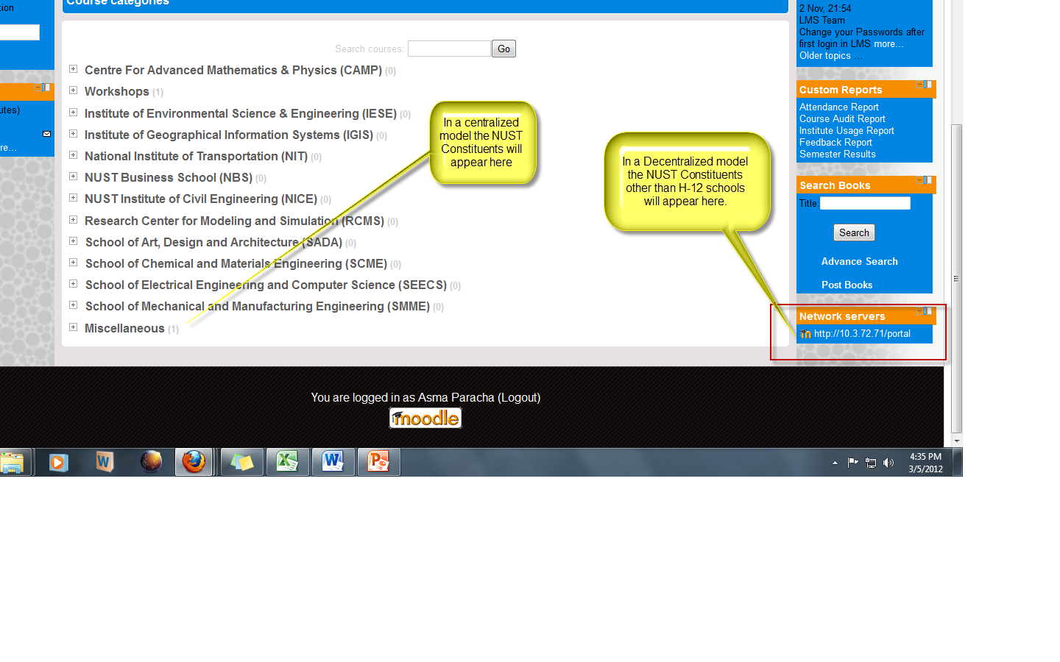
Format landing page

Slide 23
MODELS
Centralized Model
Advantages
Disadvantages
Centralized management of NUST’s learning content for efficient searching and retrieval;
Manage and allocate tasks to team to optimize the team’s full productivity;
Adhere to and enforce standard operating practices;
Consolidate tracking and reporting within a single system
standardization of processes
implement effective processes, controls and communications ;
If there is a failure at the LMS central site it would effect all the off-site campuses;
Increased responsibility for management & Server Breakdown;

Slide 24
MODELS
Centralized Model
Advantages
Disadvantages
Less Costly in terms of Hardware as the schools would be accommodated on existing setup the servers which would only require an upgrade;
Less time taken in deployment;
Less time taken in terms of Training the employees;
Encourage Uniformity & Usability;
Easily Document compliance;
Reduce the cost of maintaining multiple LMS;

Slide 25
MODELS
De-centralized Model
Advantages
Disadvantages
Less Responsibility;
Provides greater opportunities for learning through collaboration;
In case LMS Central faces any server, internet connectivity or hardware issues the offsite campuses would not be affected;
Easy Employee Management ;
Quick & Easy Hardware Maintenance and Support;
More Costly in terms of Hardware;
More time & resources required to implement
Cannot work collectively to solve problems together
De-Centralized management of NUST’s learning content would delay searching and retrieval;
Cannot enforce standard operating practices;
Requires extensive training;

Slide 26
MODELS
De-Centralized Model
Advantages
Disadvantages
In this model NUST Central & the Constituents would not Share Accountability;
NUST Central would not have to share the costs of hardware;
No networking issues would be faced;
External hosting is more cost effective than internal hosting;
The focus of NUST central would remain fixed on management of learning rather than technology issues;
Cannot implement effective processes, controls and communications ;
Presents difficulties in creating common skills and approaches across the organization

Slide 27
Implementation-MNET Network of Moodle's

Slide 28
MNET
The Moodle network feature allows a Moodle administrator to establish a link with another Moodle or a Mahara site and to share some resources with the users of that Moodle.
Once the system is configured correctly, each school has their own VLE and a central hub VLE is established to provide the inter-school collaboration platform.
Users go from the first Moodle to the linked site via the Network servers block.

Slide 29
MNET-Advantages
Learners from different schools are able to roam from their own school VLE to the central hub to participate in shared curriculum courses reducing the need to travel to the school in person.
Teachers can manage their own courses on their school VLE, share information and collaborate with other tutors from other schools in the network on the central hub.

Slide 30
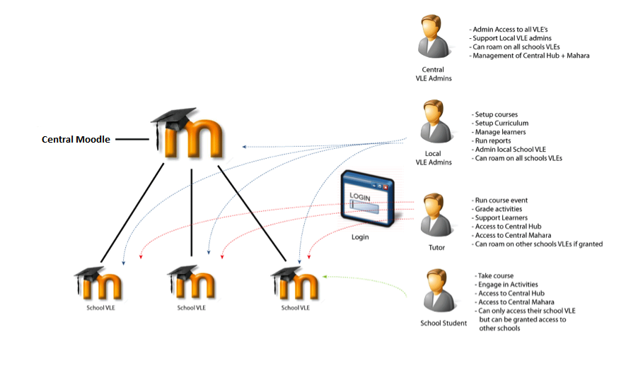
MNET-Setup

Slide 31
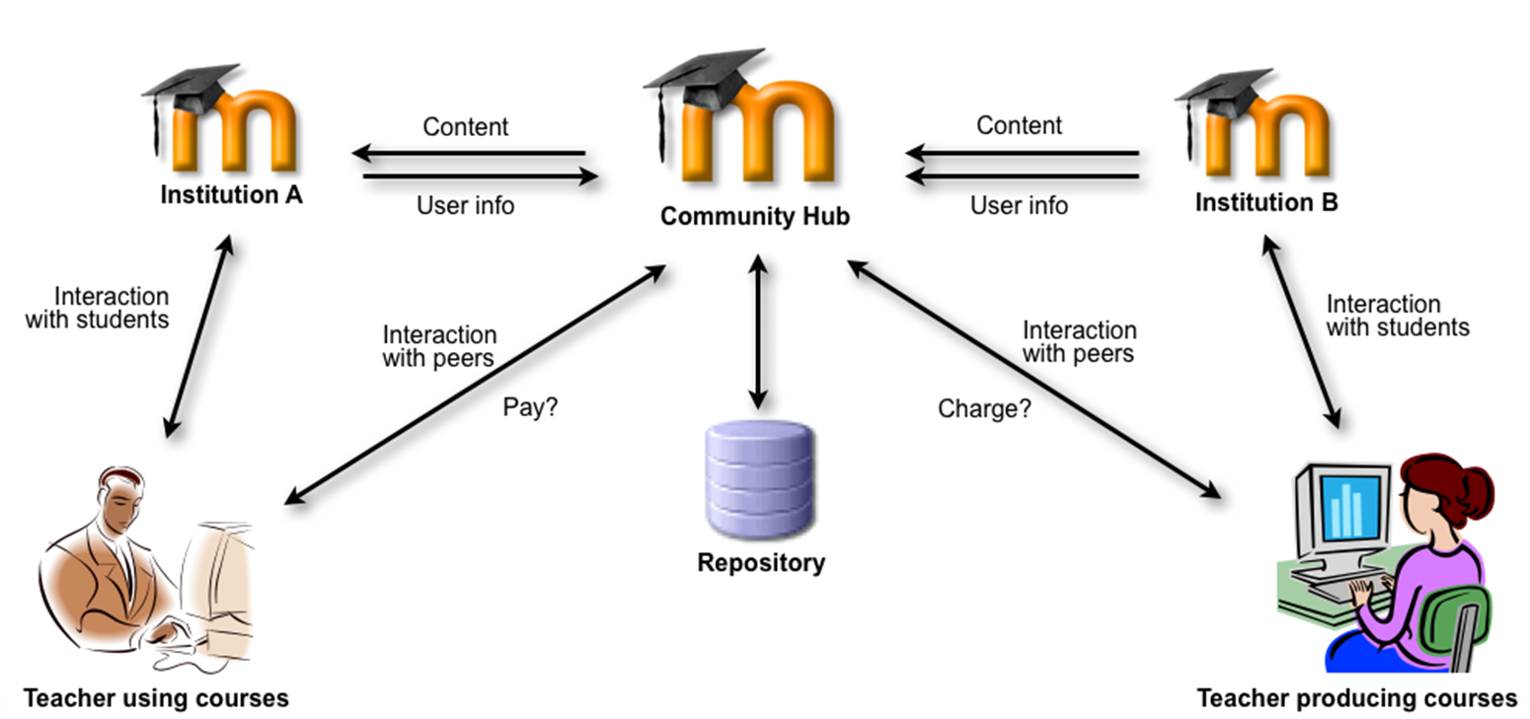
MNET-Setup

Slide 32
MODELS
A Checklist for School:
Appoint a school LMS contact
Sign and return the MoU to LMS Central
Create a Moodle group in AD/LDAP and inform Loop technical support it needs to be included in Loop directory batch process
Make arrangements with Loop technical support to setup Loop Single-Sign-On for LMS
Create implementation plan including core staff group, establish a training plan, create course category structure and format landing page
Provide LMS Central with theme customization requirements
Update LMS links on intranet/web pages
Publicize

Slide 33


